Slide 2
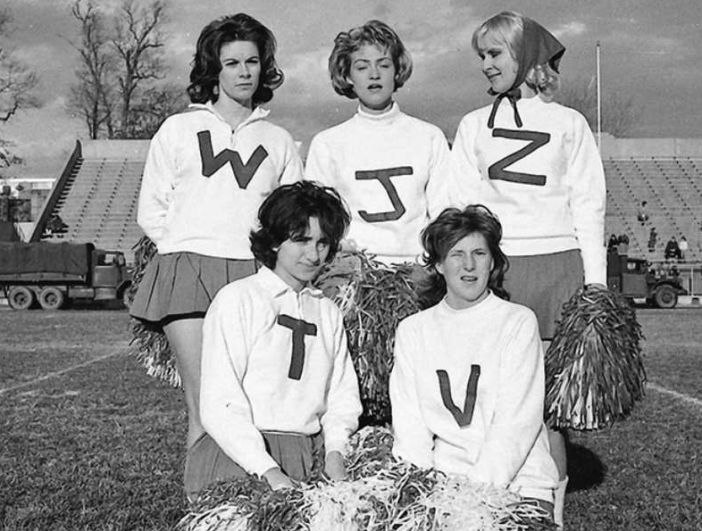
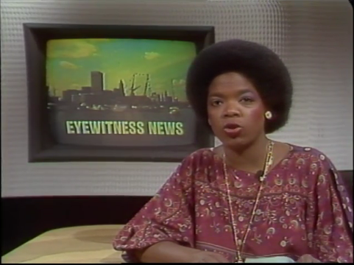
A Brief History of WJZ TV
WJZ’s first day of broadcasting was on November 1, 1948 as WAAM. The station was originally owned by Radio-Television of Baltimore Inc. Channel 13 was originally an ABC affiliate, the network's fifth outlet to be located on the East Coast. Until 1956, it carried an additional primary affiliation with the DuMont Television Network. On the station's second day of operations, WAAM broadcast the 1948 presidential election returns and various entertainment shows, remaining on the air for 23 consecutive hours. Channel 13 has been housed in the same studio facility, located near Druid Hill Park on what is now known as Television Hill, since the station's inception; the building was the first in Baltimore specifically designed for television production and broadcasting.
As a DuMont affiliate, WAAM originated many Baltimore Colts games for the network's National Football League coverage. WJZ now airs the vast majority of the NFL’s Baltimore Ravens games.
From 1957 to 1964, one of the station's highest-rated programs was The Buddy Deane Show, an in-studio teen dance show similar to ABC's American Bandstand, which WJZ-TV preempted in favor of the Deane program. Deane's program was the inspiration for the John Waters 1988 motion picture Hairspray and its subsequent Broadway musical version, which in turn was made into an acclaimed musical film in 2007.
WJZ is the home station of Oprah Winfrey, where she began her career in 1976 as a news anchor and eventually co-hosted WJZ’s local “People Are Talking” show.
WJZ is a news oriented broadcaster, airing Baltimore’s only 3 hour local evening news block (M-F/4PM-7PM).
On January 2, 1995. channel 13 became Baltimore’s CBS affiliate. Westinghouse then bought CBS on November 24, 1995, making WJZ-TV a CBS owned-and-operated station. Notably, this marked the first time that CBS had wholly owned a station in the Baltimore/Washington corridor.

Slide 3
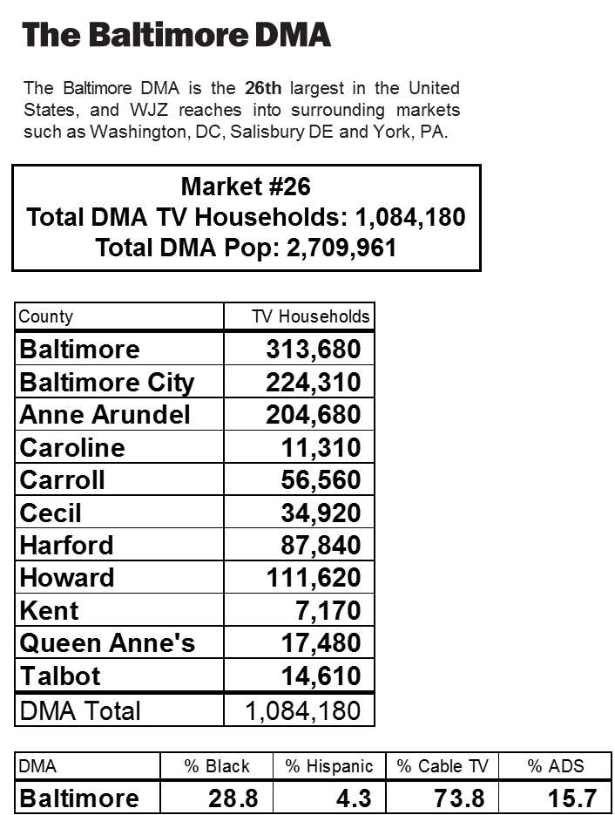
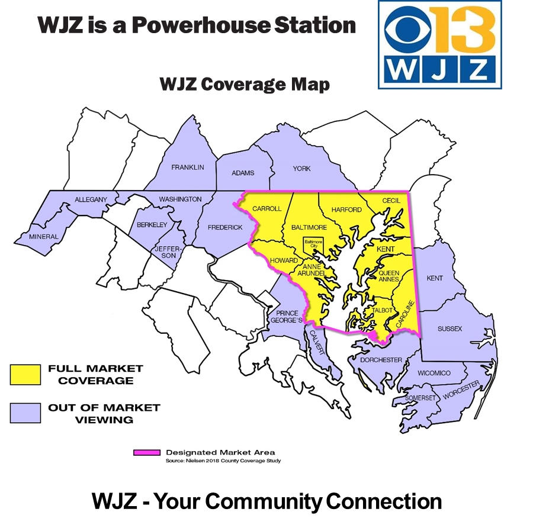
Nielsen Media Research - Baltimore, Nov’18

Slide 4
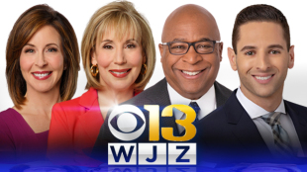
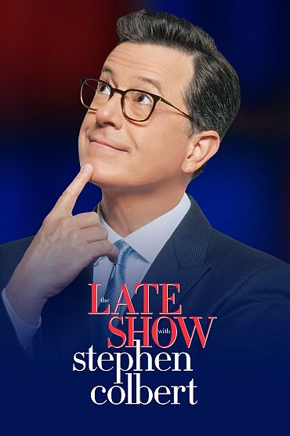
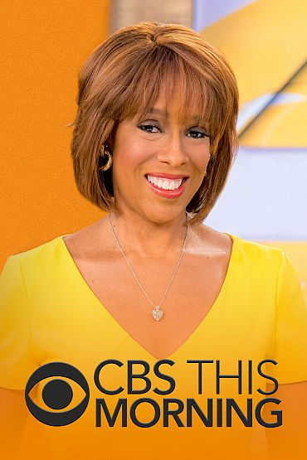
WJZ Programming

Slide 5
WJZ Special Events

Slide 6
WJZ Digital & Exclusive Sponsorships
1st quarter:
Black History Oratory Contest
March Madness Bracket Challenge
Countdown to Grammy Awards
2nd quarter:
Beach Forecast
Orioles Opening Day Special
3rd quarter:
Baltimore Ravens NFL Football
WJZ Local Ravens Purple Shows
Countdown Clock to 4th of July
Pro Football Challenge Digital Sponsorship
College Football Digital Sponsorships
4th quarter:
Baltimore Ravens NFL Football
WJZ Local Ravens Purple Shows
Digital Countdown Clock (Thanksgiving, Christmas, New Year’s Eve)
Countdown Clock to Christmas
WJZ New Year’s Eve Special
Full Year Sponsorships:
It’s Academic
WJZ Traffic Report
WJZ Weather Reports:
School Closings
Severe Weather
Mobile Weather
WJZ Morning News Crawl
WJZ News App
CBS Casting Call Sponsorships:
Survivor
Amazing Race
Price is Right
WJZ Noon News Friday Puppy
Closed Captioning
Stock Report Closing
WJZ Cube – In Studio Green Room Sponsorship
WJZ Chopper 13 - News Helicopter
WJZ News Drone Sponsorship
Ask The Expert (Call-in Phone Bank)

Slide 7
For Information on Advertising With WJZ-TV
Contact:
Tom Maguire, Director of Sales
410-578-7503 tmaguire@wjz.com
Ted Hughes, Local Sales Manager
410-578-7516 thughes@wjz.com
Rebecca Gebhard, Director of Marketing and Development
410-578-7509 rgebhard@wjz.com
Michele Wilson, National Sales Manager
410-578-3691 mwilson@wjz.com

